Slide 1
Digital Portfolio
STUDENT NAME: P.SANTHOSH
REGISTER NO AND NMID:24131061802521073/4287FB101C3C697988A4236A181B81B4
DEPARTMENT: B.SC COMPUTER SCIENCE
COLLEGE: SHREE RAGHAVENDRA ATRS & SCIENCE COLLEGE

Slide 2
PROJECT TITLE
PORTFOLIO PAGE

Slide 3


AGENDA
Problem Statement
Project Overview
End Users
Tools and Technologies
Portfolio design and Layout
Features and Functionality
Results and Screenshots
Conclusion
Github Link
3/21/2024 Annual Review

Slide 4

PROBLEM STATEMENT
Traditional resumes are limited and non-interactive.
Skills and projects are not showcased effectively.
Lack of engaging online presence reduces opportunities.
Employers/clients cannot easily explore a candidate’s work.
Need for a responsive, professional, and modern portfolio website.

Slide 5

PROJECT OVERVIEW
A personal portfolio website built using HTML, CSS, and JavaScript.
Provides sections for About Me, Projects, and Contact.
Showcases profile, skills, and completed work in a modern layout.
Responsive design for mobile, tablet, and desktop devices.
Interactive features like hover effects and a contact form with JavaScript.
Serves as a digital resume + portfolio to attract employers/clients.

Slide 6

WHO ARE THE END USERS?
• Recruiters & Hiring Managers – to evaluate your skills and projects
• Clients – to check your work before offering freelance or contract projects.
• Colleagues/Peers – to collaborate on professional or academic work. • Networking Connections – people you meet at events or online who want to know more about you. • You (the owner) – as a personal branding and self-promotion tool.

Slide 7
TOOLS AND TECHNIQUES
🔧 Tools
→ HTML5 for structure → CSS3 for styling → JavaScript for interactivity
🛠 Technique
→ Responsive web design (flexbox, grid → Single-page layout → JavaScript form validation

Slide 8
POTFOLIO DESIGN AND LAYOUT
🎨 Design
→ Simple, clean, and professional look
→ Consistent color scheme (light/dark contrast)
→ Readable fonts with proper sizing
📐 Layout • Header → Name, tagline, navigation menu • About Section → Profile picture + short bio • Projects Section → Grid/cards showcasing work
8

Slide 9
FEATURES AND FUNCTIONALITY
✨ Features
Clean, modern single-page design
Responsive layout (mobile, tablet, desktop)
About, Projects, and Contact sections
Profile picture and short bio
⚙️ Functionality
• Navigation links scroll smoothly to sections
• Hover effects on buttons and project cards
• Form validation using JavaScript

Slide 10
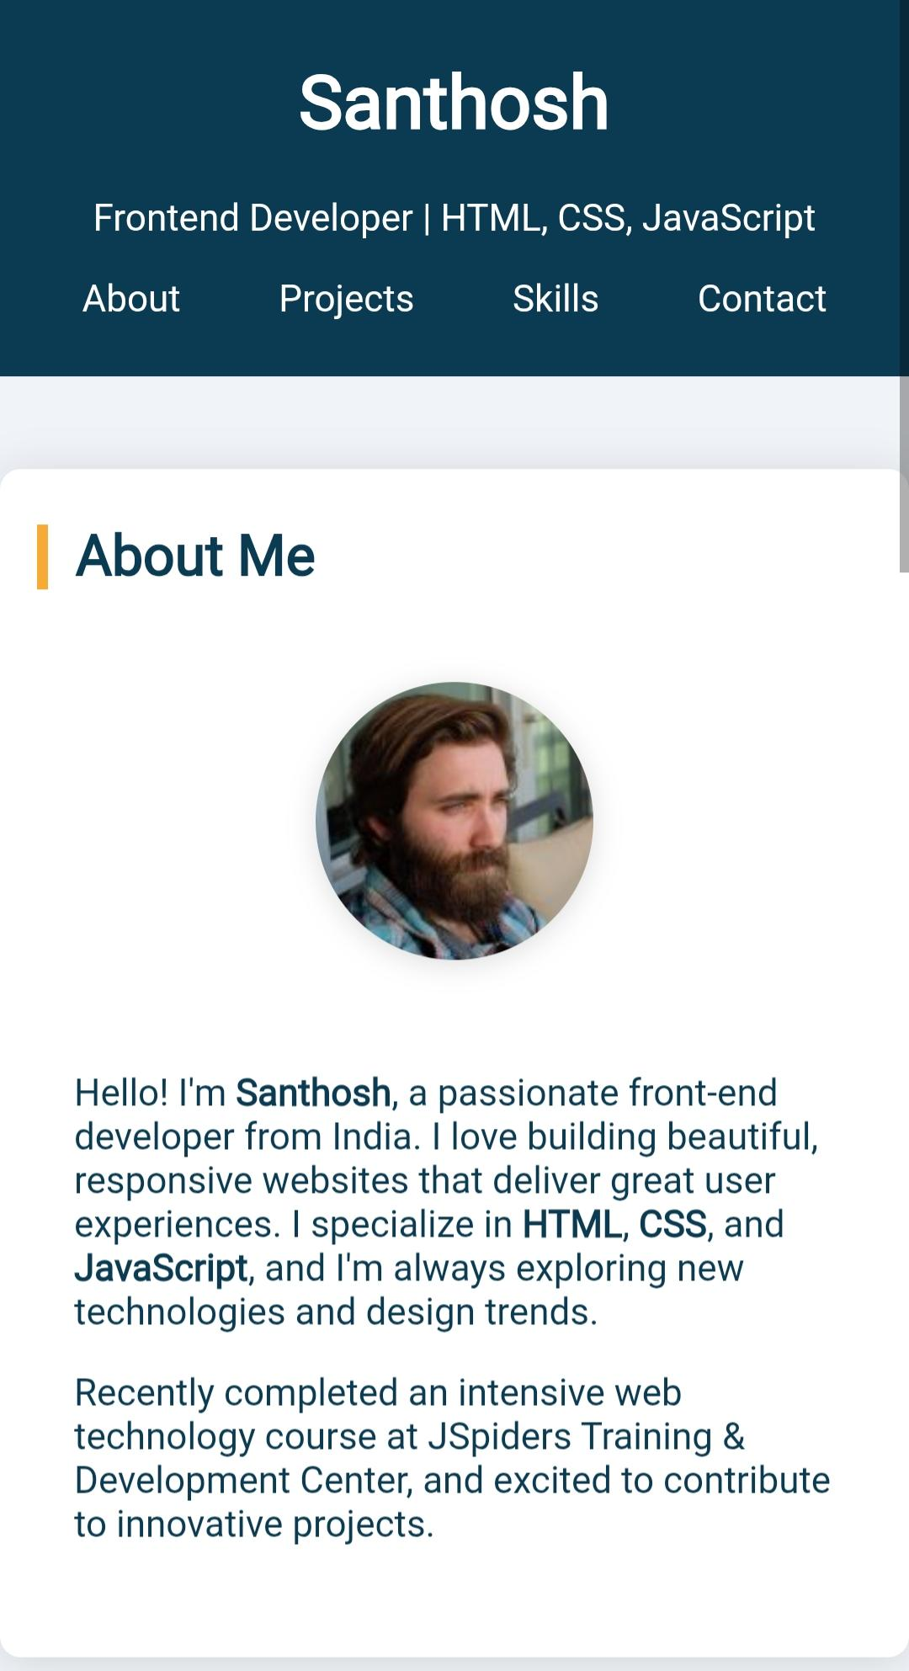
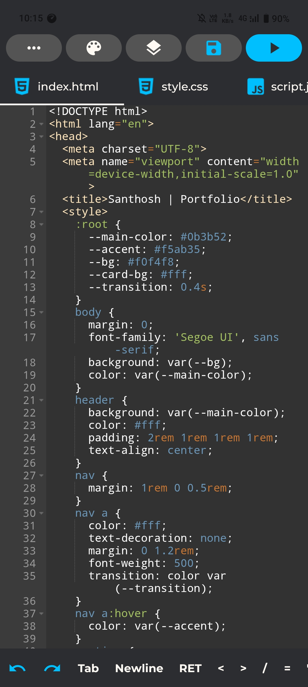

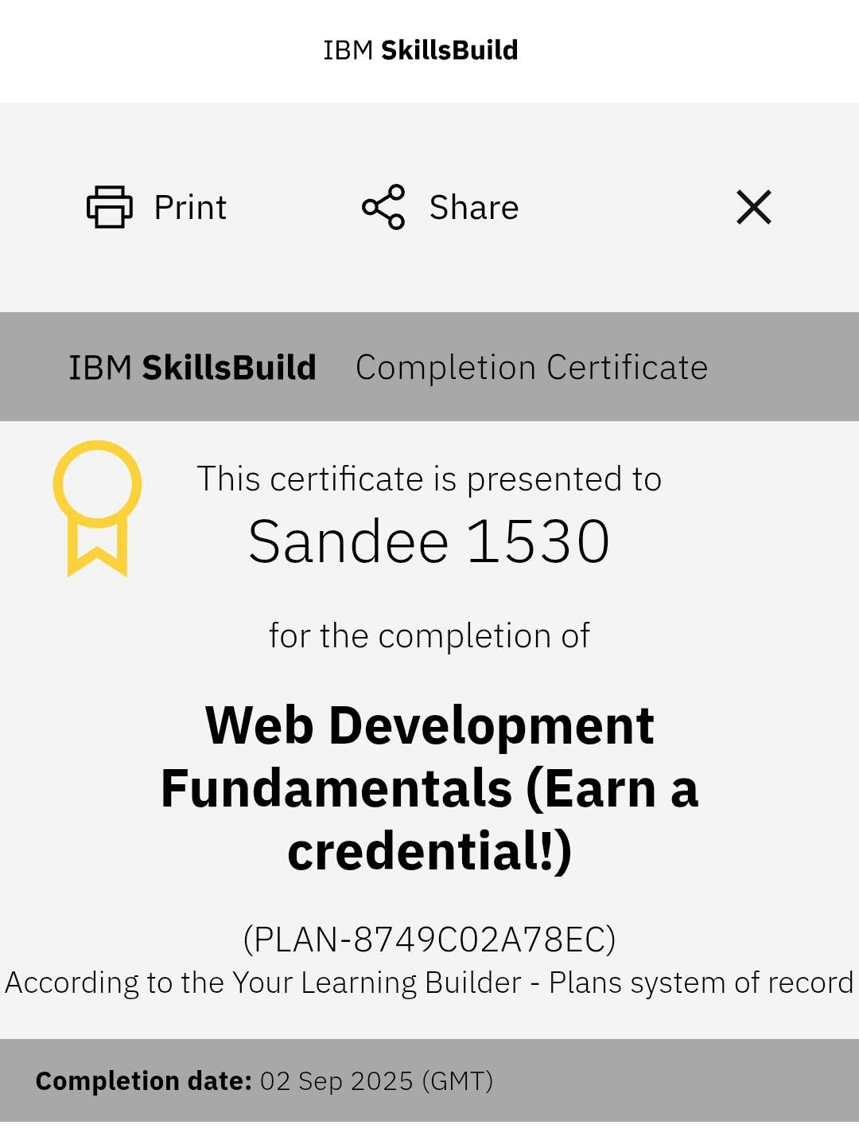
RESULTS AND SCREENSHOTS
✅ Result
A responsive single-page portfolio website was successfully created.
It includes About, Projects, and Contact sections.
The design is clean, modern, and user-friendly.
3/21/2024 Annual Review
10

Slide 11
CONCLUSION
• A responsive portfolio website was successfully developed.
• It effectively showcases profile, projects, and contact details. • The design is simple, modern, and user-friendly.
11

